Slide 1
Weekly Progress
Week 3

Slide 2
Week 3 To do
Adjust gantt chart to work smoothly with other courses as well.
Select more papers to study
Get access for the lab
Write summary of studied paper

Slide 3
New Gantt Chart

Slide 4
Reading for Week 3
8.MakeItTalk
9.MegaPortraits_Samsung AI lab
10.Model_Attribution_of_Face-Swap_Deepfake_Videos
11. PCAVS_Pos Controllable Audio Visual System.pdf
12.Realistic_Talking_Face_Synthesis_With_Geometry-Aware_Feature_Transformation.pdf
13.Talking_face_using_facial_feature_detection_and_image_transformations_for_visual_speech.pdf
14.Towards_Generating_Ultra-High_Resolution_Talking-Face_Videos_with_Lip_synchronization.pdf

Slide 5
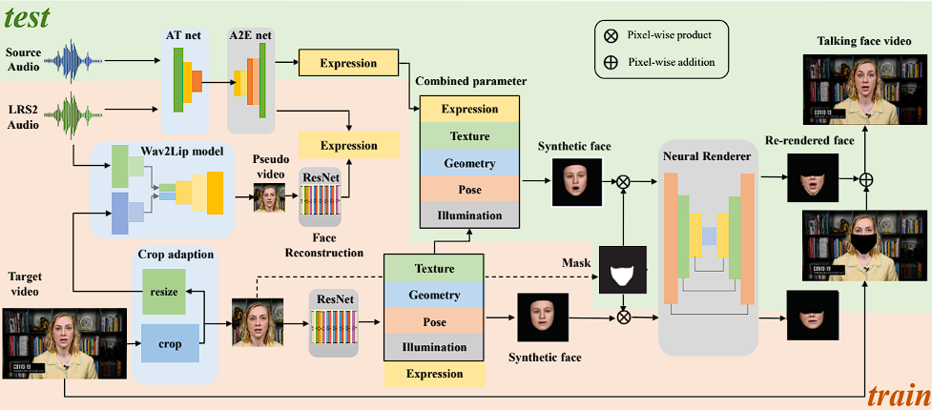
Studied paper review 1
Title: META TALK: LEARNING TO DATA-EFFICIENTLY GENERATE AUDIO-DRIVEN
LIP-SYNCHRONIZED TALKING FACE WITH HIGH DEFINITION
Datasets: A2E + Wav2Lip+ 3DMM
OverView:

Slide 6
Studied paper review 1
Crop the original target video into target face video, resize to be low resolution to generate a low definition talking face video (LRS2 audio and pre-trained model Wav2Lip) → crop to 256 *256
The generated video- audio pair is the pseudo label which possesses abundant phonemes and corresponding talking face video with excellent lip synchronisation.
3D face reconstruction is performed on both the pseudo video and the target video, and 3DMM (facial 3D morphable model) parameters including expression, geometry, texture, pose, illumination coefficients are extracted from each frame of them.
A new audio-to-expression(A2E) transformation network is trained with audio-expression pairs of the pseudo video to obtain a powerful model mapping audio to expression parameters. ( transfer the powerful lip synchronisation performance of wave2lip to A2E network).
The 3DMM parameters are used to re-render the synthetic facial images in the target video.
Train a neural rendering network with the lower half of synthetic and real target faces to generate a high-definition photo-realistic talking face video.
During the testing phase, arbitrary audio can be input and fed into the trained audio-to-expression transformation network to predict audio-driven expression parameters. Then, the predicted expression parameters replace the original ones
of 3DMM parameters obtained by 3D reconstruction.
Then re render the face to audio-driven synthetic face using the combined 3DMM parameters.
Then the lower half of the generated synthetic face is translated to a realistic lower half face.
Finally, the generated photo-realistic lower half face is sewn into the background of the original target video to generate a high-definition lip-synchronised video.

Slide 7
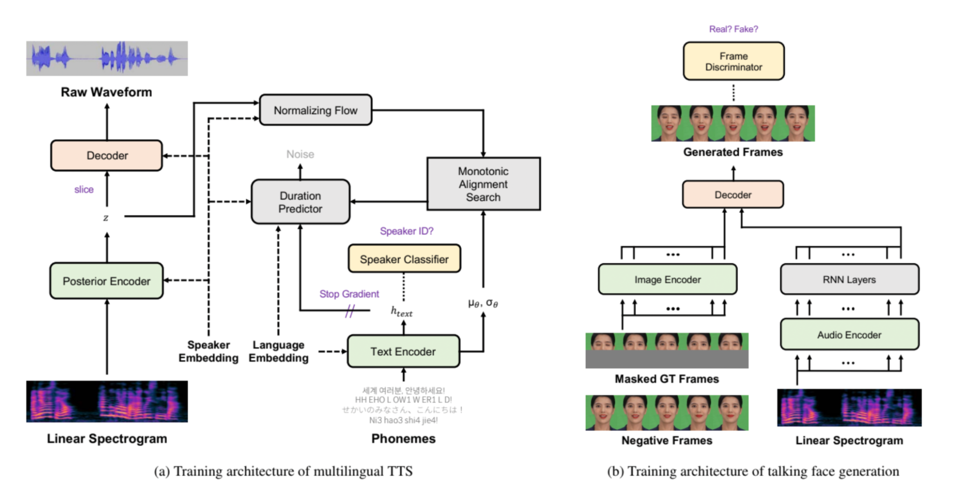
Studied paper review 2
Title: Talking_Face_Generation_with_Multilingual_TTS
Datasets:
OverView:

Slide 8
Studied paper review 2
The proposed system consists of three main modules: a preprocessor module, a multilingual TTS module, and a talking face generation module. (First, the preprocessor module transforms the input text to a phoneme sequence. The multilingual TTS module, in turn, generates a raw speech waveform based on the phoneme sequence with the designated speaker identity. Subsequently, the talking face generation module synthesises the final output video with the lip movement synchronised to the input speech.)
Preprocessor: to convert raw text into a sequence of phonemes
cleans the text by removing any character or symbol that does not belong to the specified language. Then the text goes through a normalisation procedure, converting non-verbal texts(e.g., digits, dates, and short forms of words, to their verbal-ised forms. Finally, the preprocessor maps all graphemes in the text to phonemes. → use different ones for different languages
Multilingual TTS: use multi-speaker VITS as the base model for the multilingual TTS module. To enable multilingual speech synthesis for VITS, add embeddings for each language and input them to submodules. Our preliminary experiments showed that injecting the language embedding to the text encoder and the duration predictor yields the best result. (refer to this setting as the multilingual VITS)
Talking face generation: an image encoder, an audio encoder, and a decoder.
The image encoder and the audio encoder extract features from the input image and the audio, respectively. Concatenate the extracted features from both encoders and feed them to the decoder, which then generates lip synchronized face images.
For training, used the original VITS training. + apply domain adversarial training
to minimise the speaker information leakage to the encoded text representations. & add a speaker classifier with a gradient reversal layer after the text
Encoder.

Slide 9
Studied paper review 3
Title: Speech_Driven_Talking_Face_Generation_From_a_Single_Image_and_an_Emotion_Condition
Datasets : Crowd-sourced Emotional Multimodal Actors Dataset (CREMA-D) dataset
OverView:
Use emotions as an input condition to the system. The motivation is to decouple the speech and emotion conditions. (allows to manipulate emotions during the generation of face videos. Generator network architecture is built based on [S. E. Eskimez, R. K. Maddox, C. Xu, and Z. Duan, “End-to-end generation of talking faces from noisy speech,” in Proc. Int. Conf. Acoust., Speech Signal Process., 2020, pp. 1948–1952.],with a modification to accept the emotion condition input. For the discriminator networks, use one discriminator to distinguish between emotions expressed in videos, and another discriminator to distinguish between the real and generated video frames.

Slide 10
Todo for Week 4
Get access for the lab
Get more resources to understand our project
Summary studied paper
Run and check the current project

